Slide 1
Computer vision: models, learning and inference
Chapter 8
Regression

Slide 2
Structure
Linear regression
Bayesian solution
Non-linear regression
Kernelization and Gaussian processes
Sparse linear regression
Dual linear regression
Relevance vector regression
Applications
Computer vision: models, learning and inference. ©2011 Simon J.D. Prince
2

Slide 3
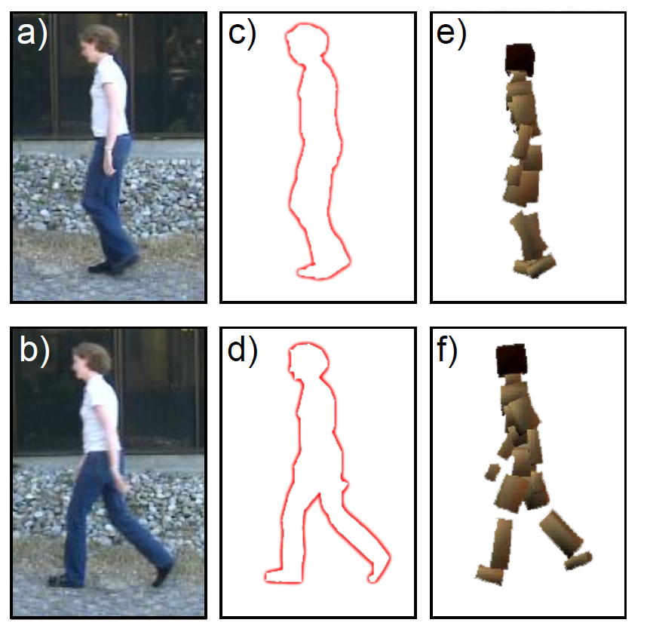
Body Pose Regression
Encode silhouette as 100x1 vector, encode body pose as 55 x1 vector. Learn relationship
Computer vision: models, learning and inference. ©2011 Simon J.D. Prince
3

Slide 4
Type 1: Model Pr(w|x) - Discriminative
How to model Pr(w|x)?
Choose an appropriate form for Pr(w)
Make parameters a function of x
Function takes parameters θ that define its shape
Learning algorithm: learn parameters θ from training data x,w
Inference algorithm: just evaluate Pr(w|x)
Computer vision: models, learning and inference. ©2011 Simon J.D. Prince
4

Slide 5
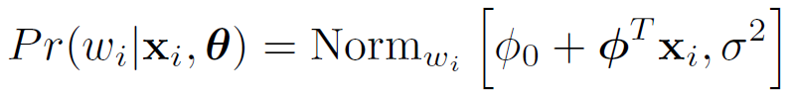

Linear Regression
For simplicity we will assume that each dimension of world is predicted separately.
Concentrate on predicting a univariate world state w.
Choose normal distribution over world w
Make
Mean a linear function of data x
Variance constant
Computer vision: models, learning and inference. ©2011 Simon J.D. Prince
5

Slide 6
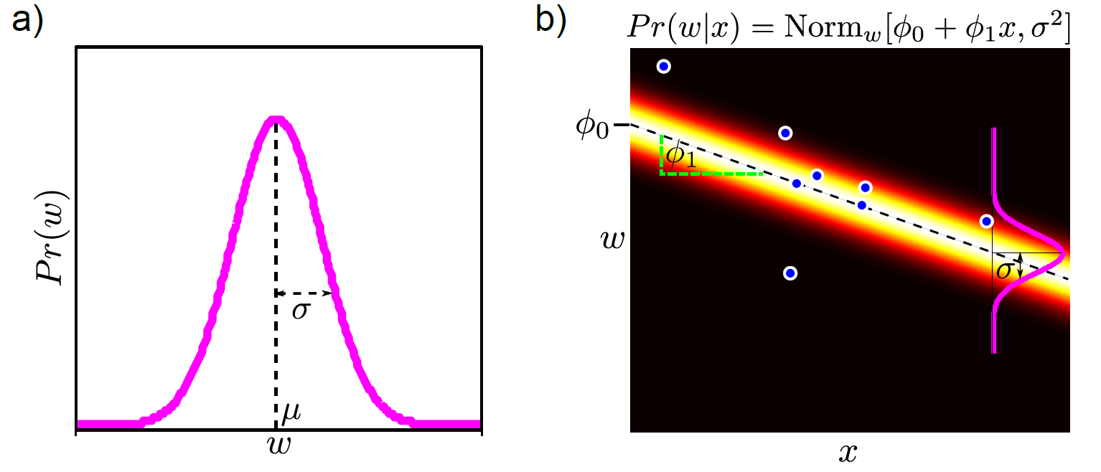
Linear Regression
Computer vision: models, learning and inference. ©2011 Simon J.D. Prince
6

Slide 7
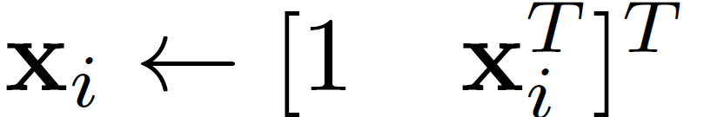
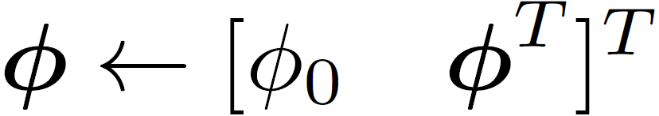
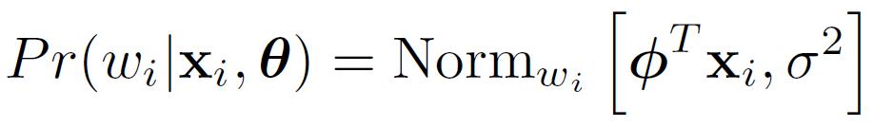

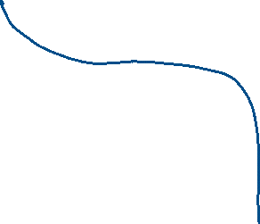
Neater Notation
To make notation easier to handle, we
Attach a 1 to the start of every data vector
Attach the offset to the start of the gradient vector φ
New model:
Computer vision: models, learning and inference. ©2011 Simon J.D. Prince
7

Slide 8
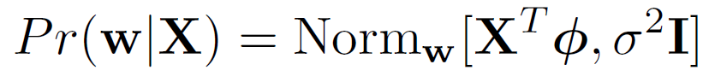
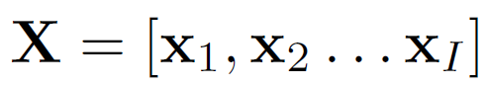
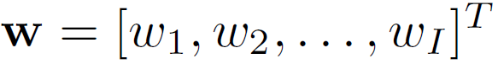








Combining Equations
We have one equation for each x,w pair:
The probability of the whole dataset is the product of these individual distributions and can be written as
where
Computer vision: models, learning and inference. ©2011 Simon J.D. Prince
8

Slide 9
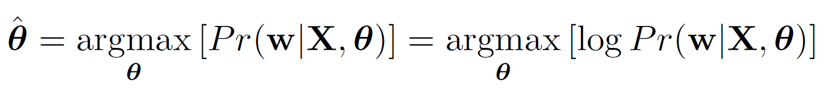
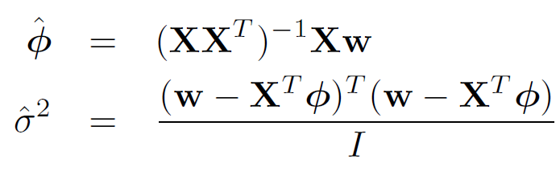
Learning
Maximum likelihood
Substituting in
Take derivative, set result to zero and re-arrange:
Computer vision: models, learning and inference. ©2011 Simon J.D. Prince
9

Slide 10
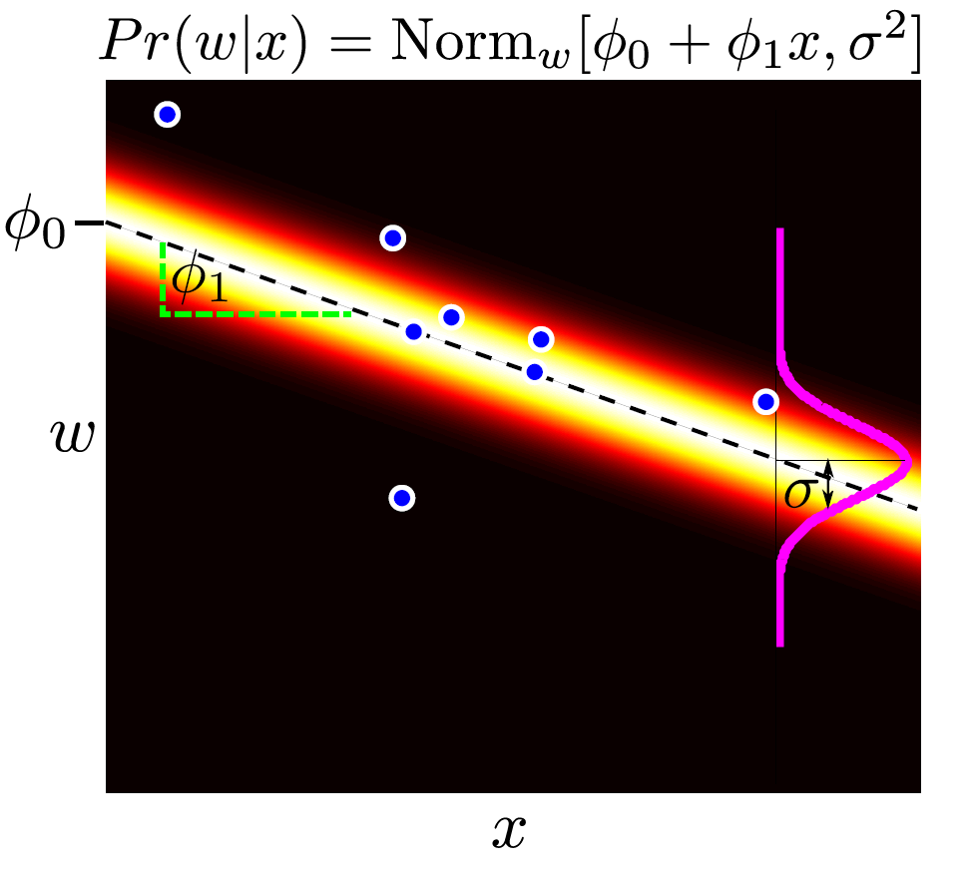
Computer vision: models, learning and inference. ©2011 Simon J.D. Prince
10

Slide 11
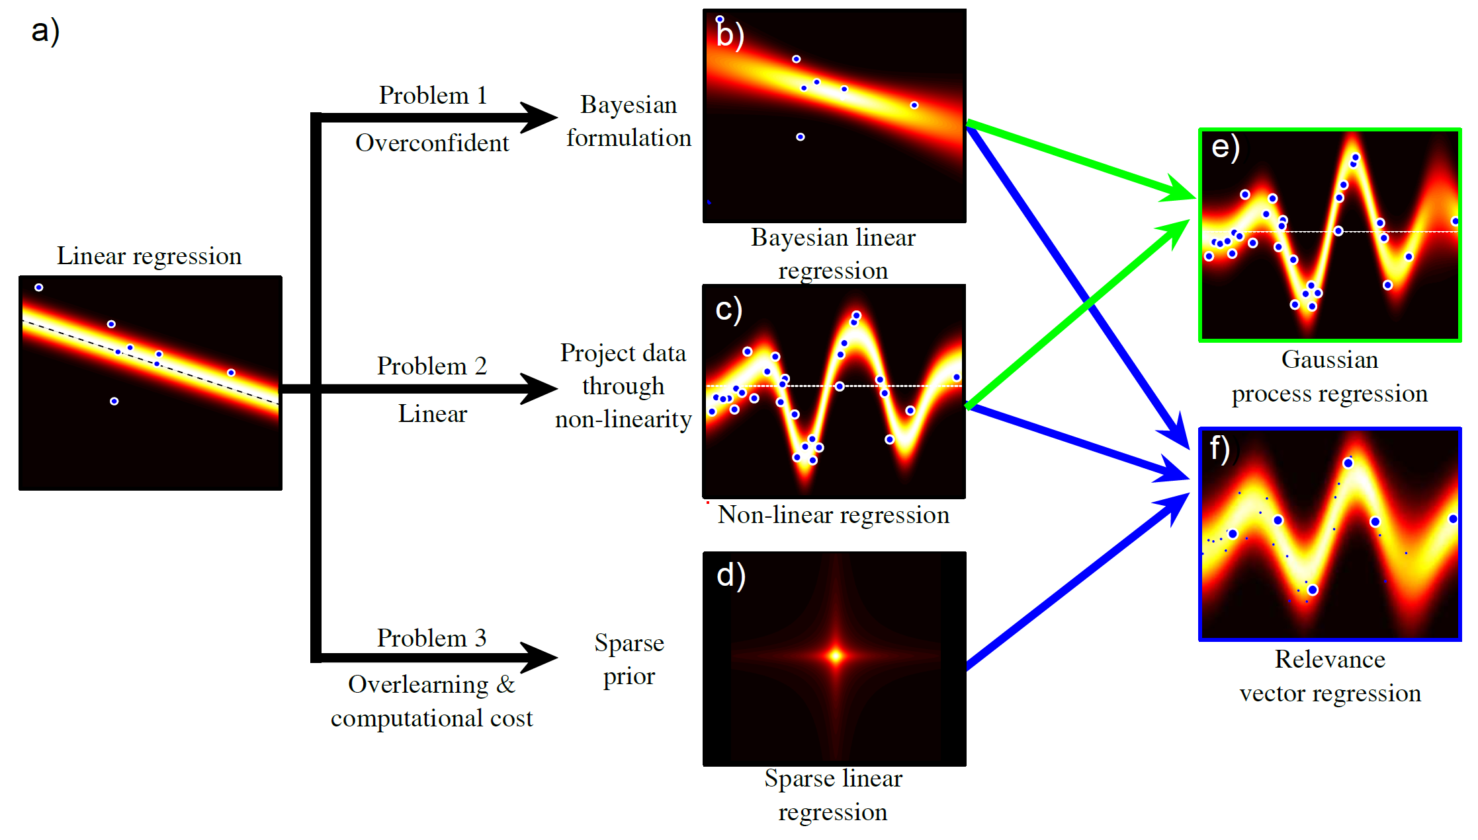
Regression Models
Computer vision: models, learning and inference. ©2011 Simon J.D. Prince
11

Slide 12
Structure
Linear regression
Bayesian solution
Non-linear regression
Kernelization and Gaussian processes
Sparse linear regression
Dual linear regression
Relevance vector regression
Applications
Computer vision: models, learning and inference. ©2011 Simon J.D. Prince
12

Slide 13
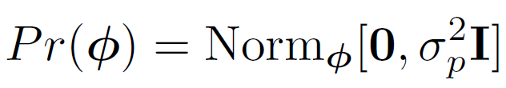
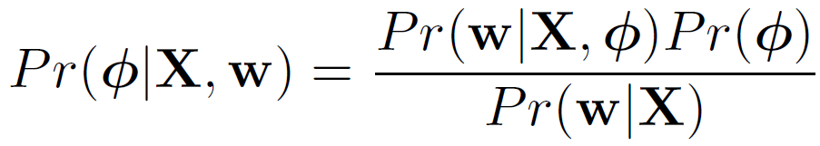
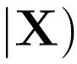





Bayesian Regression
(We concentrate on φ – come back to σ² later!)
Likelihood
Prior
Bayes rule’
Computer vision: models, learning and inference. ©2011 Simon J.D. Prince
13

Slide 14
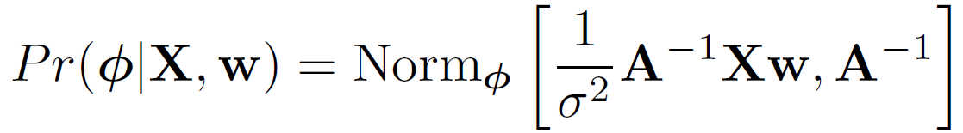
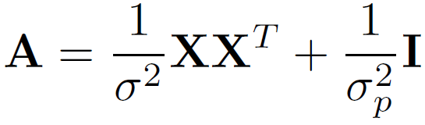
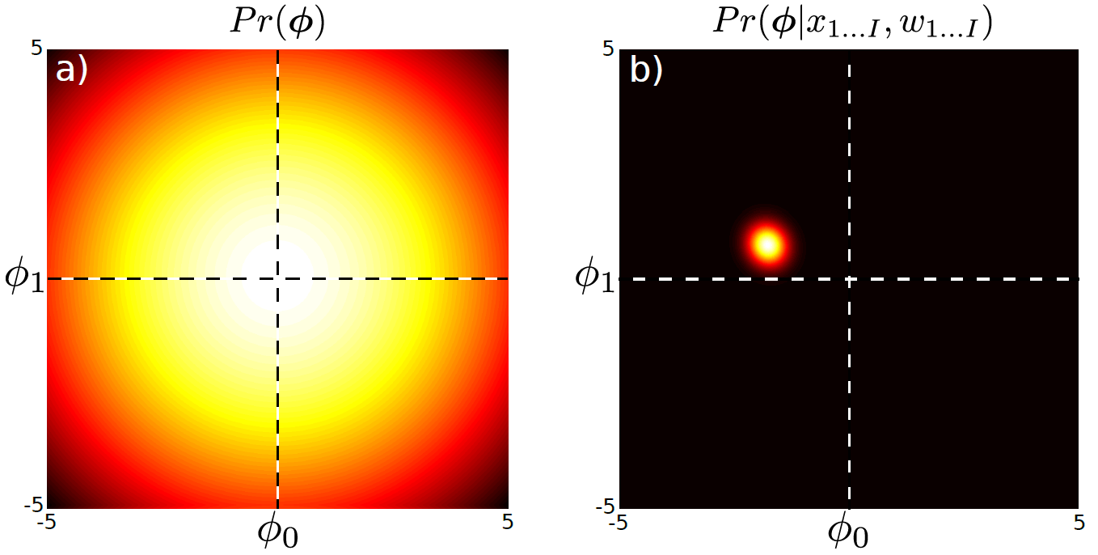

Posterior Dist. Over Parameters
where
Computer vision: models, learning and inference. ©2011 Simon J.D. Prince
14

Slide 15
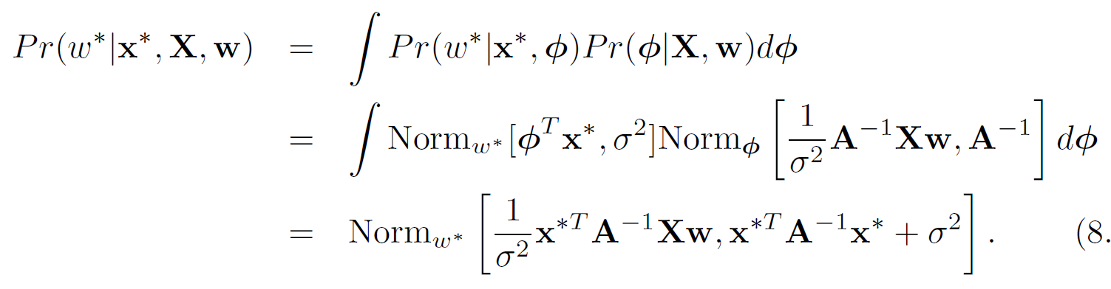
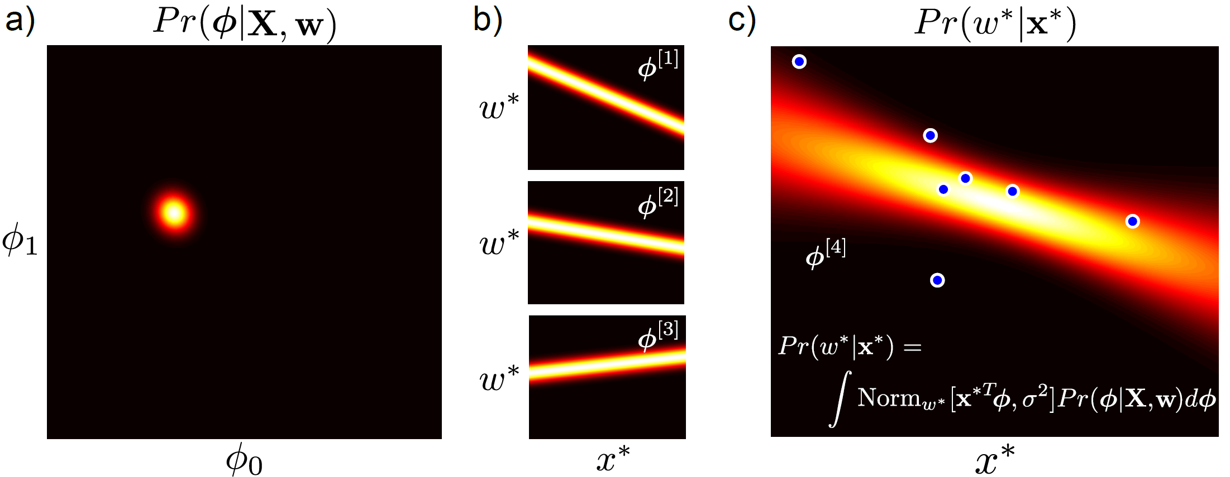


Inference
Computer vision: models, learning and inference. ©2011 Simon J.D. Prince
15

Slide 16
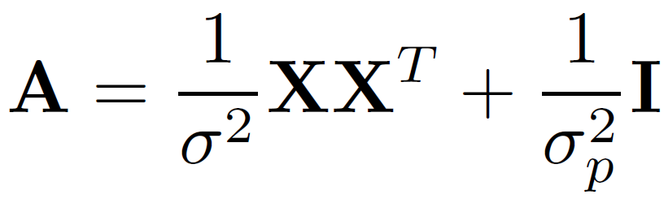
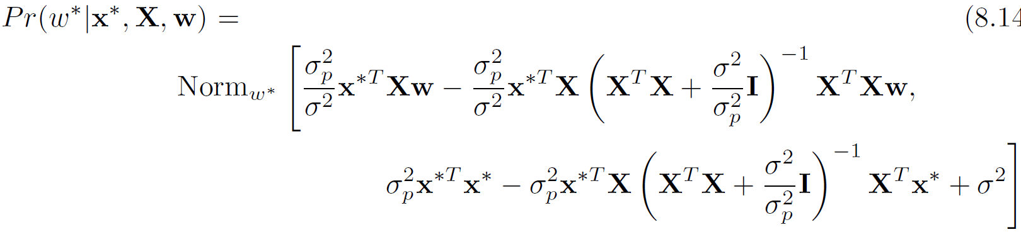

Practical Issue
Problem: In high dimensions, the matrix A may be too big to invert
Solution: Re-express using Matrix Inversion Lemma
Final expression: inverses are (I x I) , not (D x D)
Computer vision: models, learning and inference. ©2011 Simon J.D. Prince
16

Slide 17
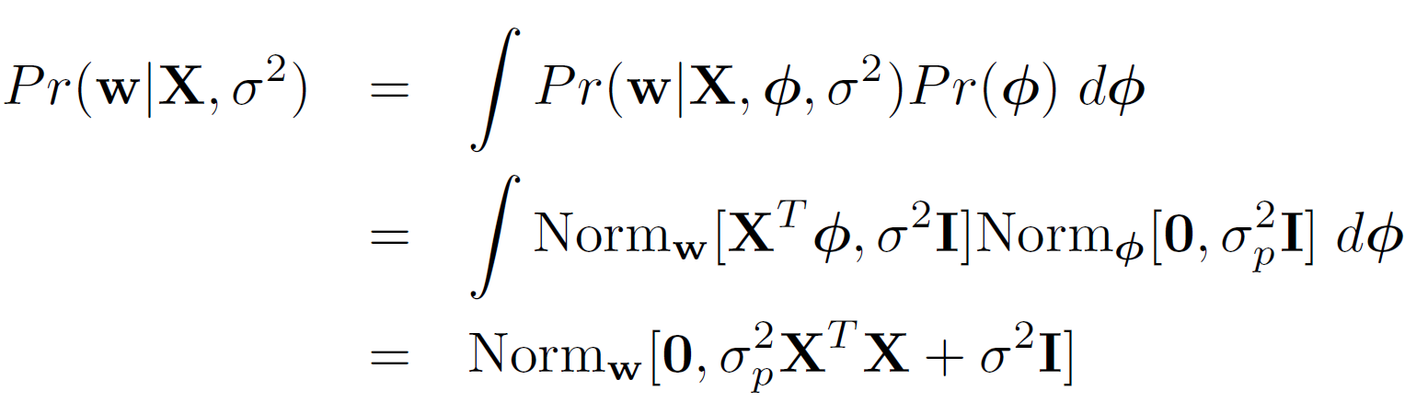




Fitting Variance
这页想讲什么：
这个公式实际上是在说，通过对所有可能的φ进行积分，我们可以得到w的边际分布，它服从均值为0，方差为σ_p^2 X^T X + σ^2 I 的多元正态分布。通过最大化这个边际似然，我们可以估计出最优的噪声方差σ^2
如何拟合方差（前面的come back to pihfang later
）（，并优化边际似然）
We’ll fit the variance with maximum likelihood
Optimize the marginal likelihood (likelihood after gradients have been integrated out)
Computer vision: models, learning and inference. ©2011 Simon J.D. Prince
17

Slide 18
Structure
Linear regression
Bayesian solution
Non-linear regression
Kernelization and Gaussian processes
Sparse linear regression
Dual linear regression
Relevance vector regression
Applications
Computer vision: models, learning and inference. ©2011 Simon J.D. Prince
18

Slide 19
Regression Models
Computer vision: models, learning and inference. ©2011 Simon J.D. Prince
19

Slide 20
Non-Linear Regression
GOAL:
Keep the math of linear regression, but extend to more general functions
KEY IDEA:
You can make a non-linear function from a linear weighted sum of non-linear basis functions
Computer vision: models, learning and inference. ©2011 Simon J.D. Prince
20

Slide 21
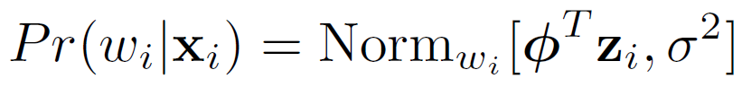
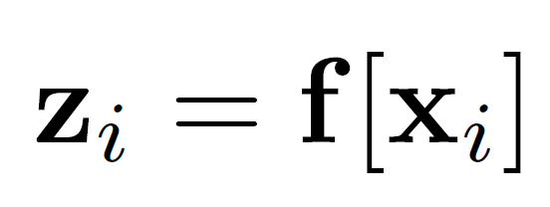
Non-linear regression
Linear regression:
Non-Linear regression:
where
In other words, create z by evaluating x against basis functions, then linearly regress against z.
Computer vision: models, learning and inference. ©2011 Simon J.D. Prince
21

Slide 22
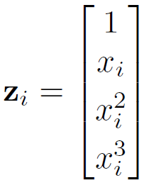
Example: polynomial regression
A special case of
Where
Computer vision: models, learning and inference. ©2011 Simon J.D. Prince
22

Slide 23
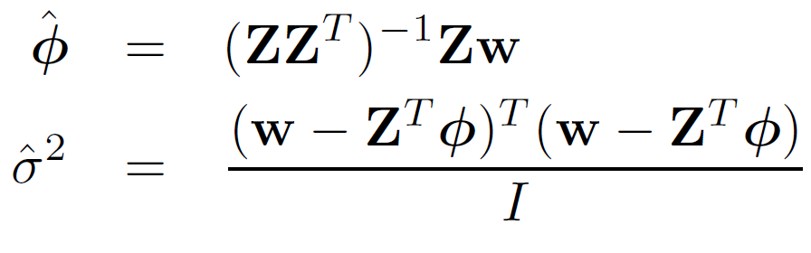

Maximum Likelihood
Same as linear regression, but substitute in Z for X:
Computer vision: models, learning and inference. ©2011 Simon J.D. Prince
23

Slide 24
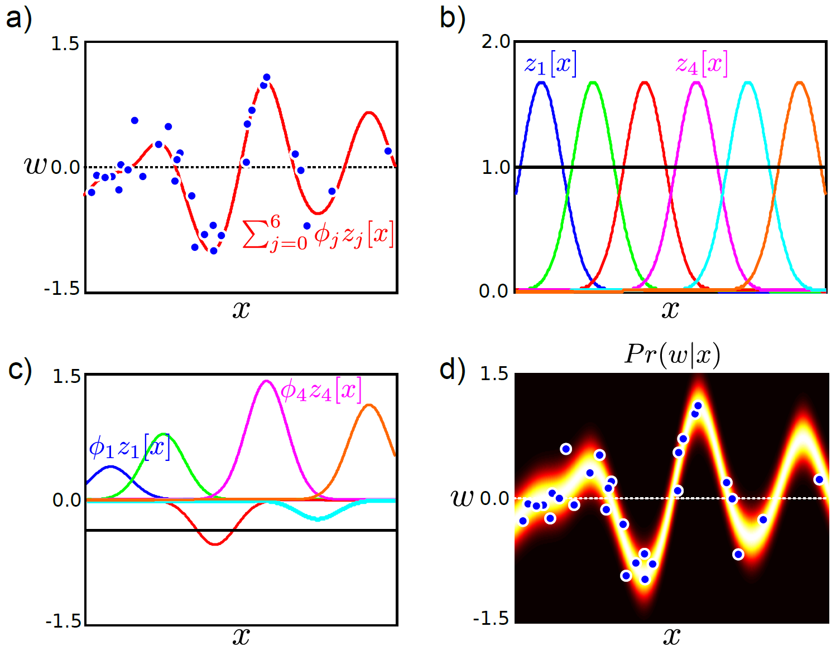
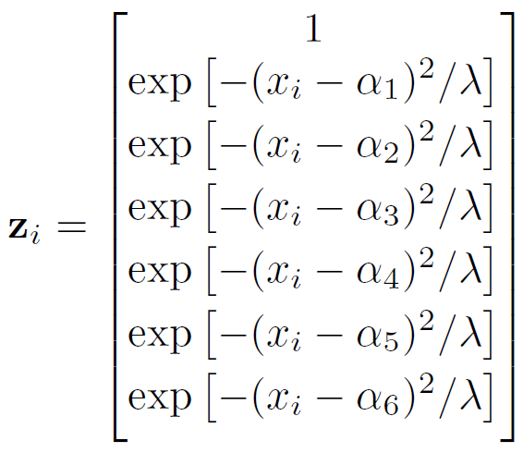





Radial basis functions
Computer vision: models, learning and inference. ©2011 Simon J.D. Prince
24

Slide 25
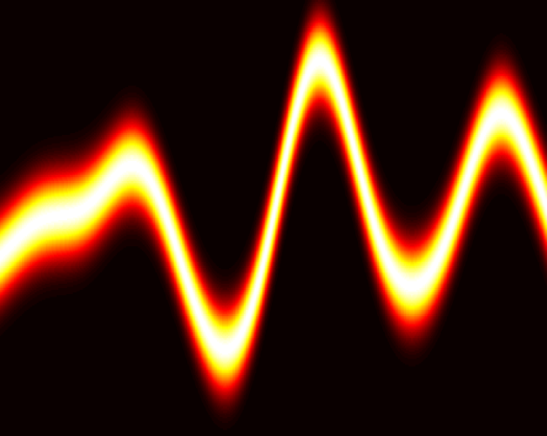
Radial basis functions
Computer vision: models, learning and inference. ©2011 Simon J.D. Prince
25

Slide 26
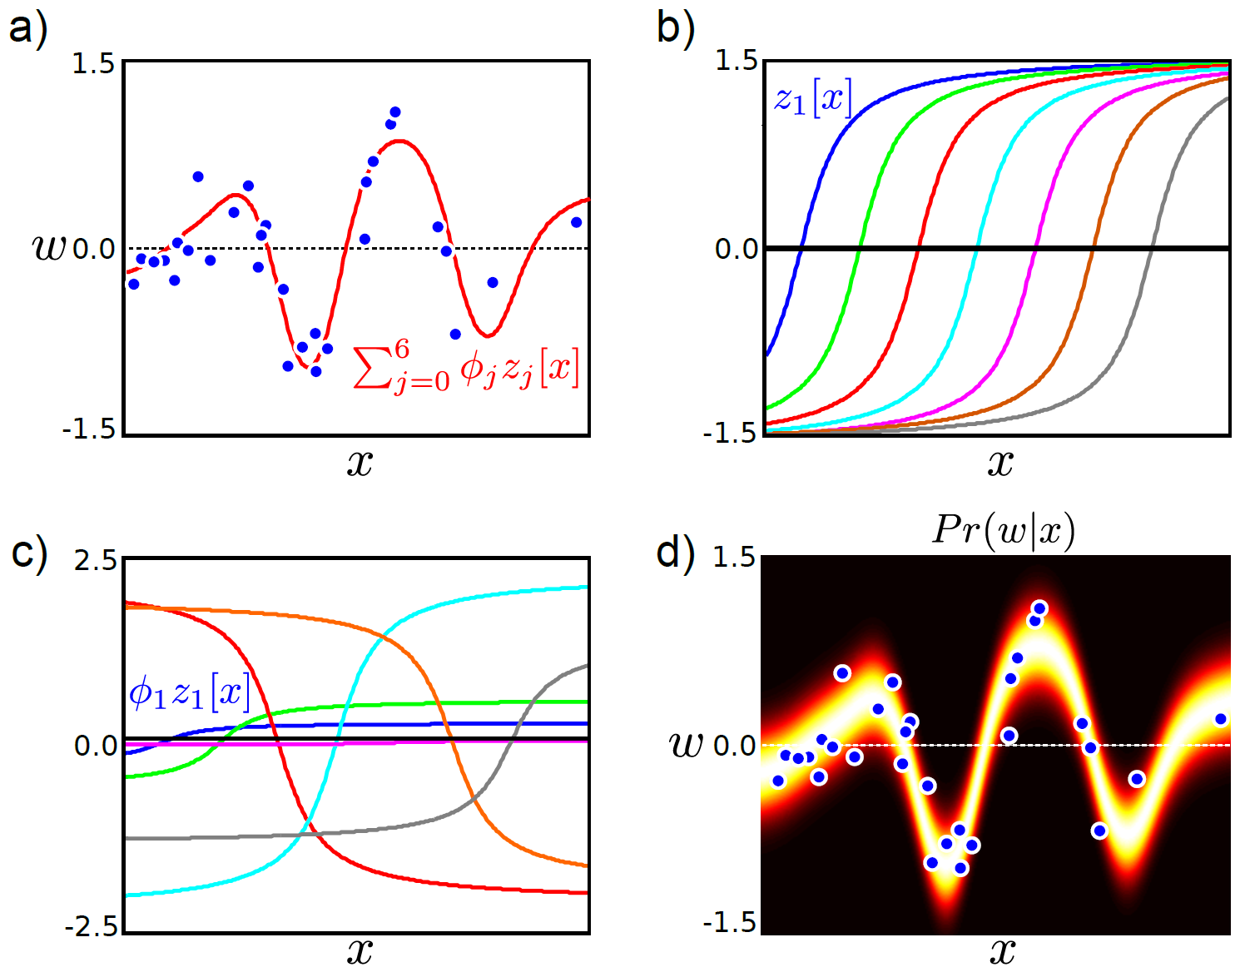
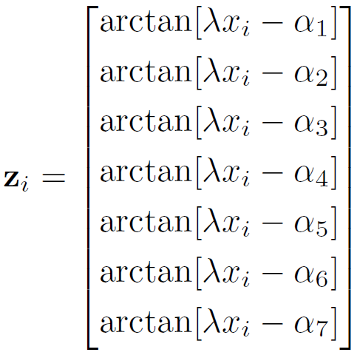


Arc Tan Functions
Computer vision: models, learning and inference. ©2011 Simon J.D. Prince
26

Slide 27
Non-linear regression
Linear regression:
Non-Linear regression:
where
In other words, create z by evaluating x against basis functions, then linearly regress against z.
Computer vision: models, learning and inference. ©2011 Simon J.D. Prince
27

Slide 28
Structure
Linear regression
Bayesian solution
Non-linear regression
Kernelization and Gaussian processes
Sparse linear regression
Dual linear regression
Relevance vector regression
Applications
Computer vision: models, learning and inference. ©2011 Simon J.D. Prince
28

Slide 29
Regression Models
Computer vision: models, learning and inference. ©2011 Simon J.D. Prince
29

Slide 30
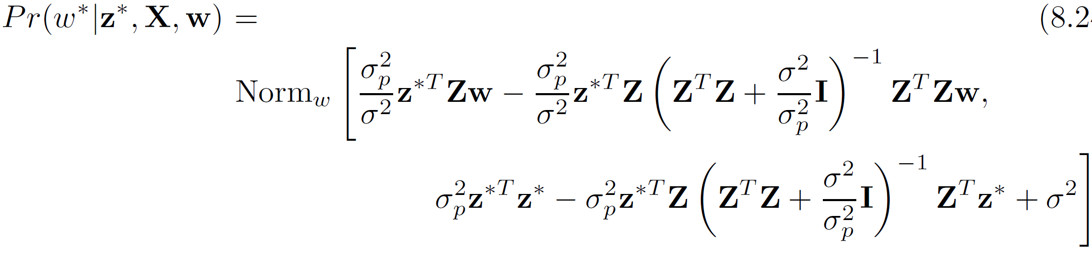
Bayesian Approach
Learn σ² from marginal likelihood as before
Final predictive distribution:
(compare to before, i.e. Bayesian-derived linear regression)
Computer vision: models, learning and inference. ©2011 Simon J.D. Prince
30

Slide 31
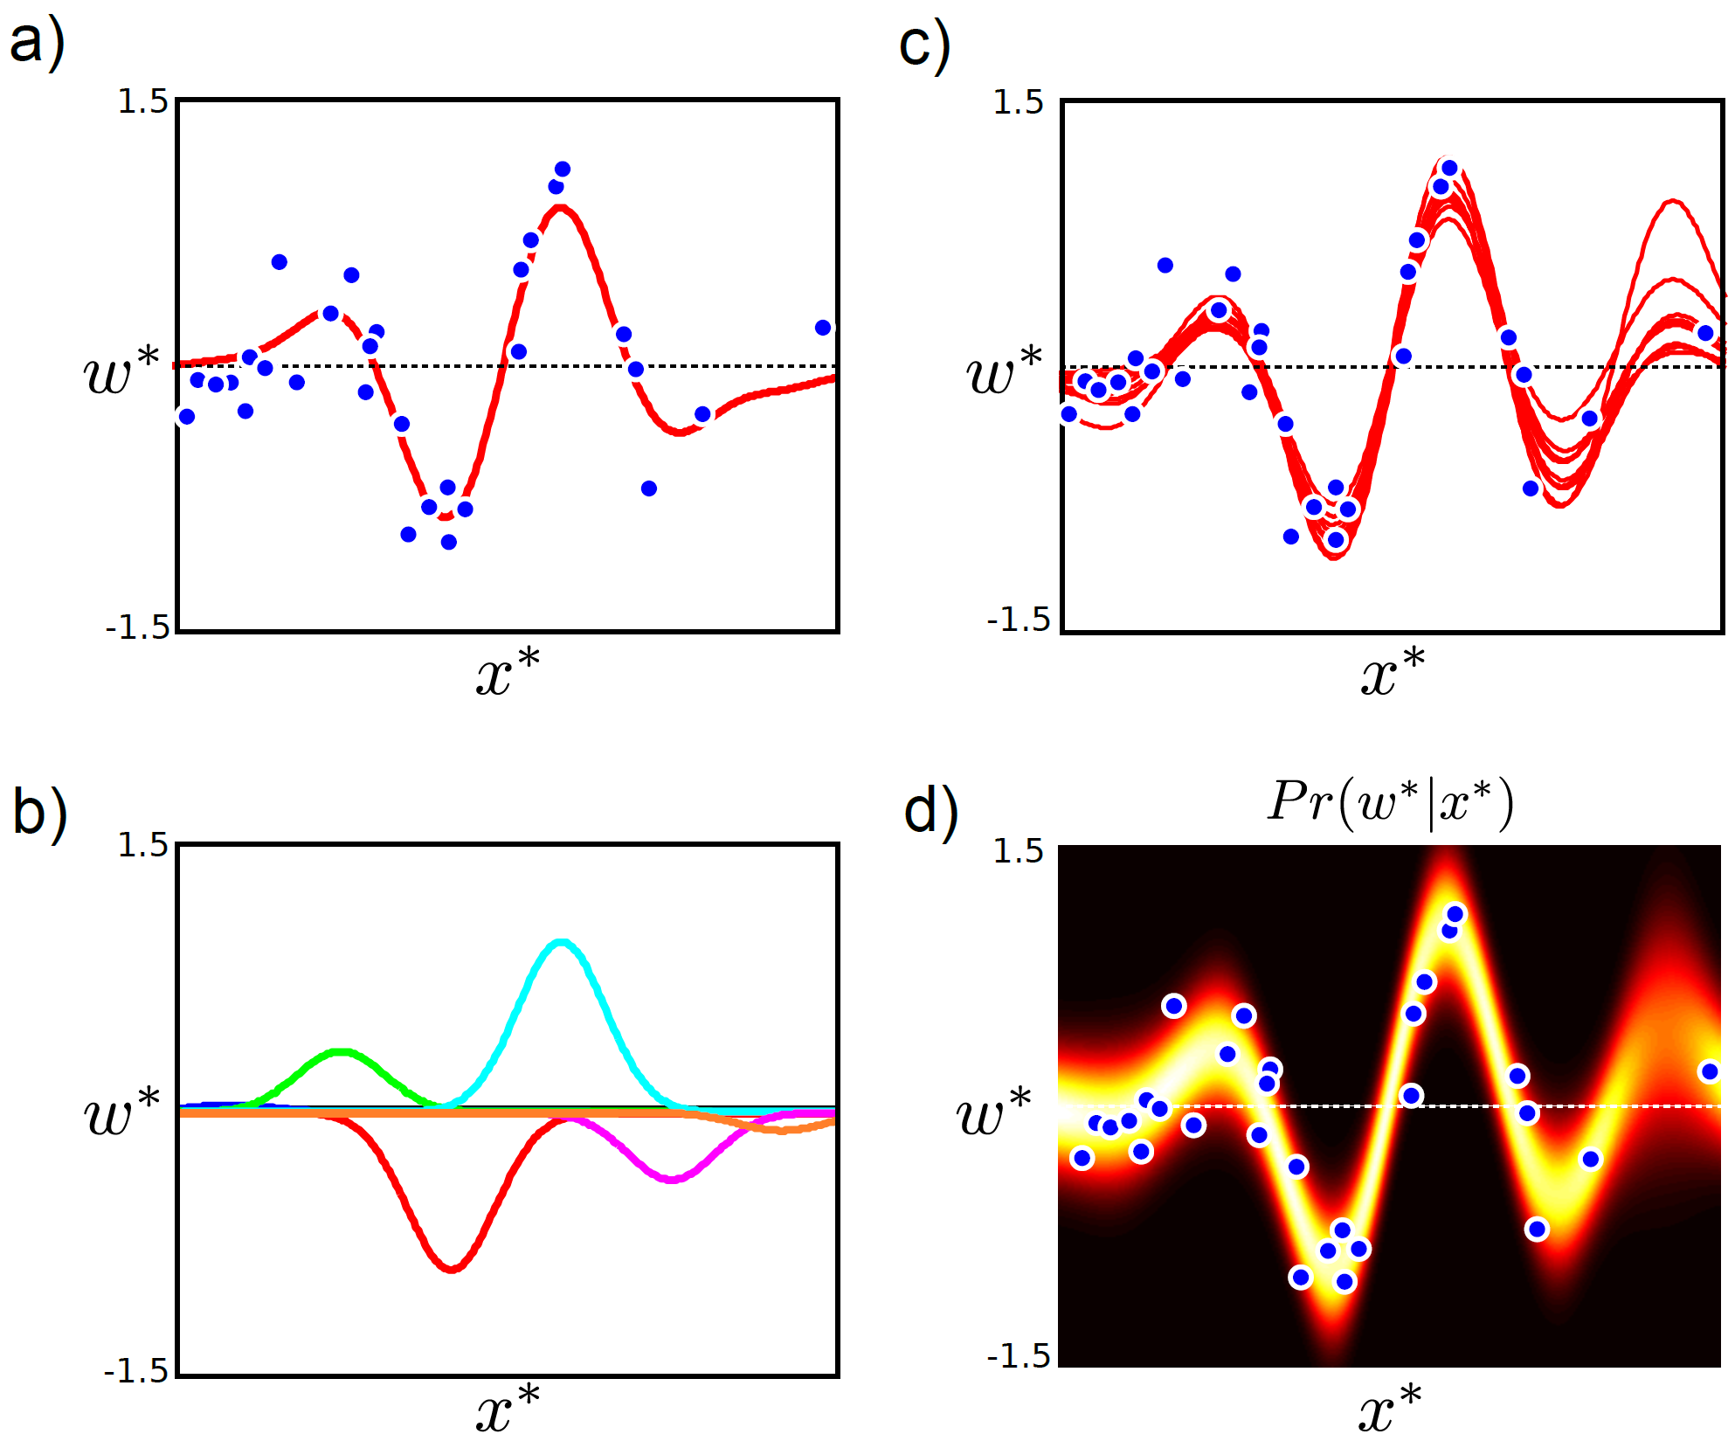
Computer vision: models, learning and inference. ©2011 Simon J.D. Prince
31

Slide 32



The Kernel Trick
Notice that the final equation doesn’t need the data itself, but just dot products between data items of the form z_{i}^{T}z_{j}
So, we take data x_{i} and x_{j} pass through non-linear function to create z_{i} and z_{j} and then take dot products of different z_{i}^{T}z_{j}
Computer vision: models, learning and inference. ©2011 Simon J.D. Prince
32

Slide 33

The Kernel Trick
So, we take data x_{i} and x_{j} pass through non-linear function to create z_{i} and z_{j} and then take dot products of different z_{i}^{T}z_{j}
Key idea:
Define a “kernel” function that does all of this together.
Takes data x_{i} and x_{j}
Returns a value for dot product z_{i}^{T}z_{j}
If we choose this function carefully, then it will correspond to some underlying z=f[x].
Never compute z explicitly - can be very high or infinite dimension
Computer vision: models, learning and inference. ©2011 Simon J.D. Prince
33

Slide 34
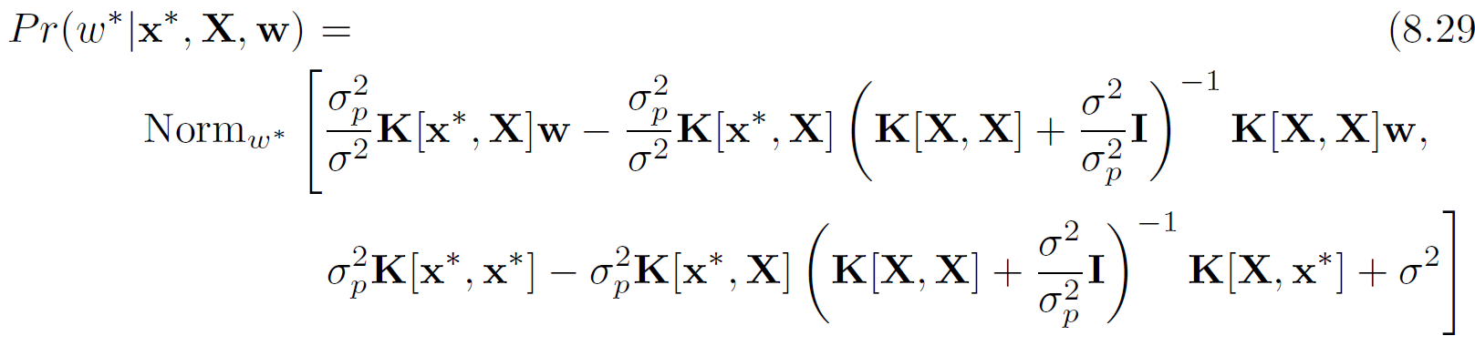
Gaussian Process Regression
Before
After
Computer vision: models, learning and inference. ©2011 Simon J.D. Prince
34

Slide 35
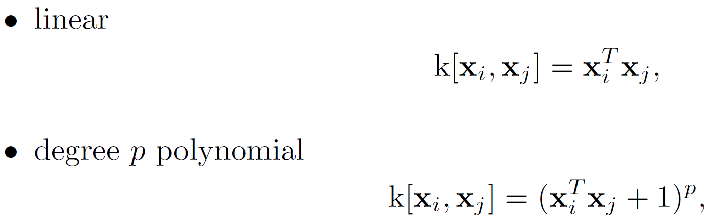
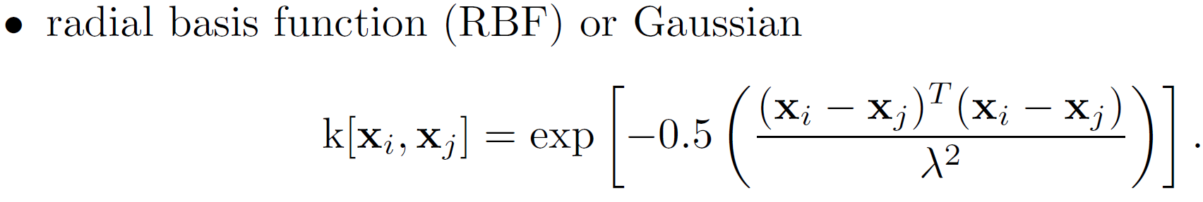

Example Kernels
(Equivalent to having an infinite number of radial basis functions at every position in space. Wow!)
Computer vision: models, learning and inference. ©2011 Simon J.D. Prince
35

Slide 36
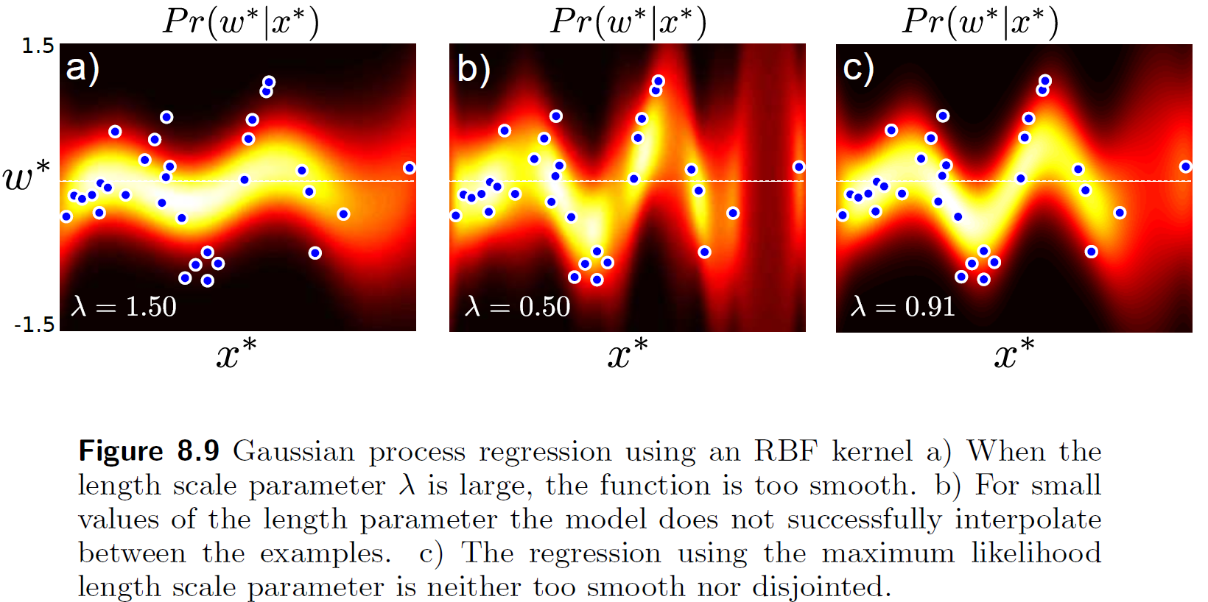
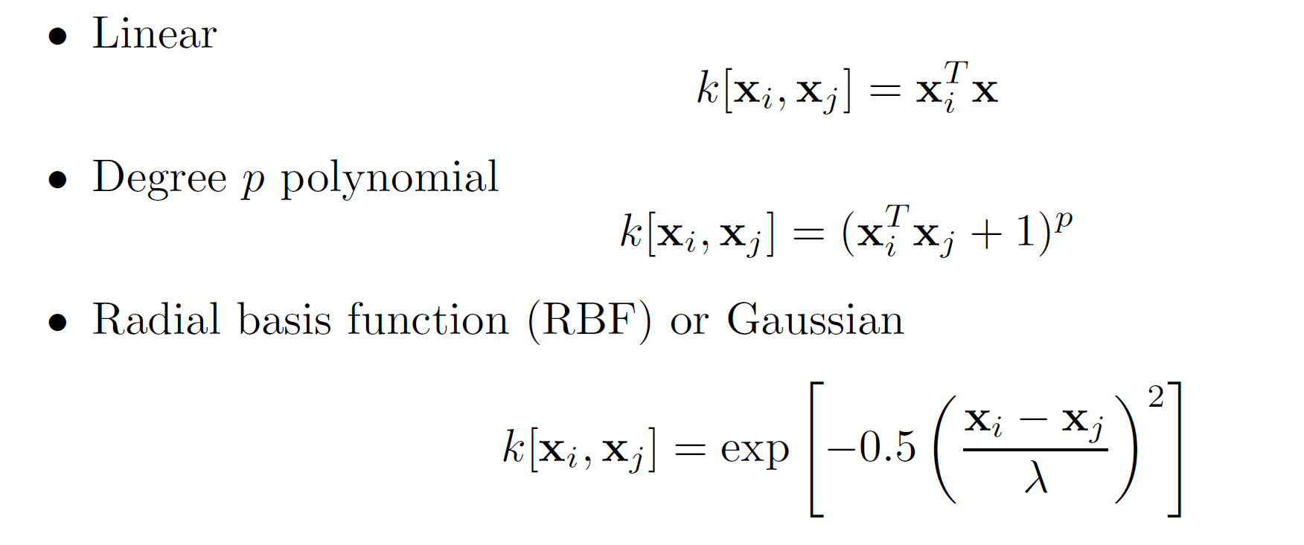
RBF Kernel Fits
Computer vision: models, learning and inference. ©2011 Simon J.D. Prince
36

Slide 37
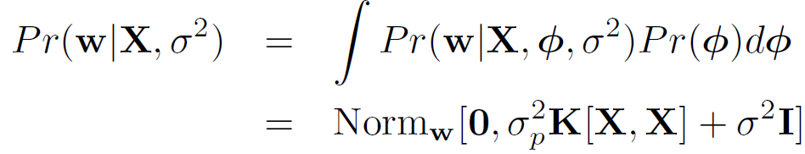
Fitting Variance
We’ll fit the variance with maximum likelihood
Optimize the marginal likelihood (likelihood after gradients have been integrated out)
Have to use non-linear optimization
Computer vision: models, learning and inference. ©2011 Simon J.D. Prince
37

Slide 38
Structure
Linear regression
Bayesian solution
Non-linear regression
Kernelization and Gaussian processes
Sparse linear regression
Dual linear regression
Relevance vector regression
Applications
Computer vision: models, learning and inference. ©2011 Simon J.D. Prince
38

Slide 39
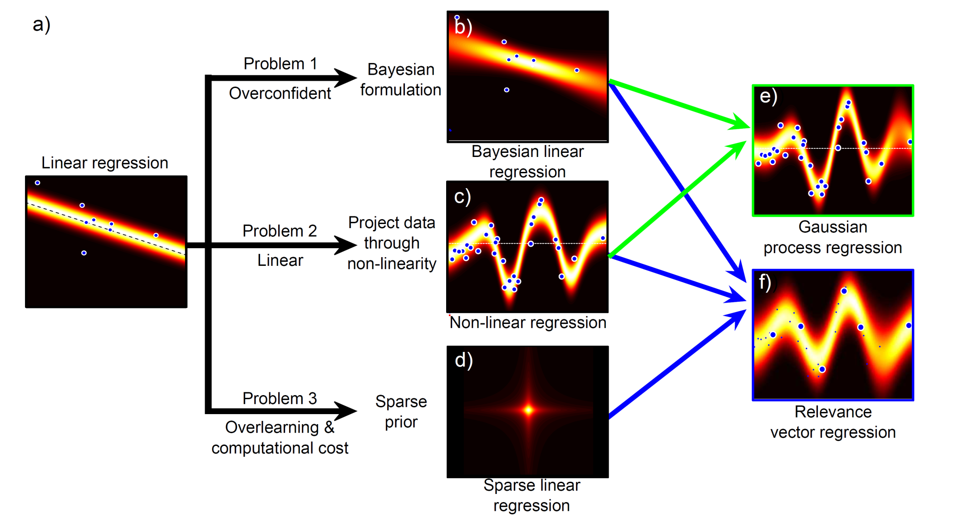
Regression Models
Computer vision: models, learning and inference. ©2011 Simon J.D. Prince
39

Slide 40
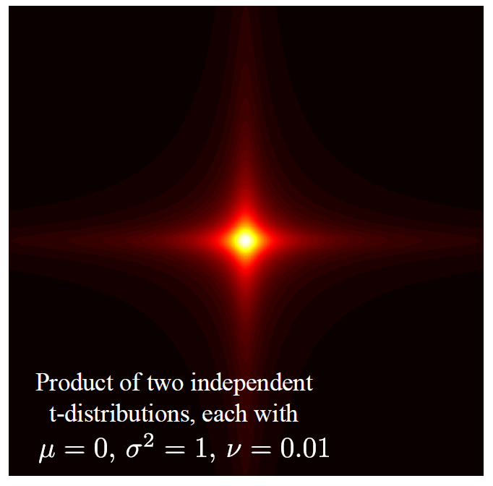
Sparse Linear Regression
Perhaps not every dimension of the data x is informative
A sparse solution forces some of the coefficients in φ to be zero
Method:
– apply a different prior on φ that
encourages sparsity
– product of t-distributions
Computer vision: models, learning and inference. ©2011 Simon J.D. Prince
40

Slide 41
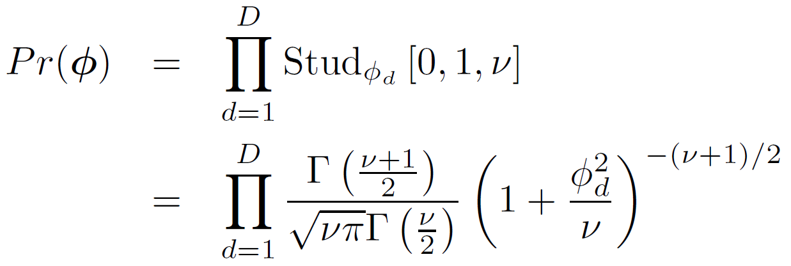
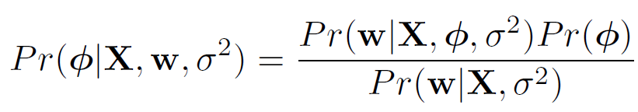
Sparse Linear Regression
Apply product of t-distributions to parameter vector
As before, we use
Now the prior is not conjugate to the normal likelihood. Cannot compute posterior in closed from
Computer vision: models, learning and inference. ©2011 Simon J.D. Prince
41

Slide 42
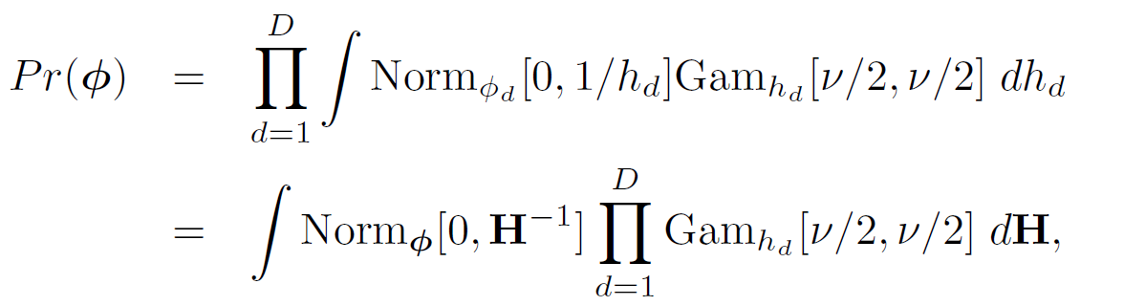
Sparse Linear Regression
To make progress, write as marginal of joint distribution
Diagonal matrix with hidden variables {h_{d}} on diagonal
Computer vision: models, learning and inference. ©2011 Simon J.D. Prince
42

Slide 43
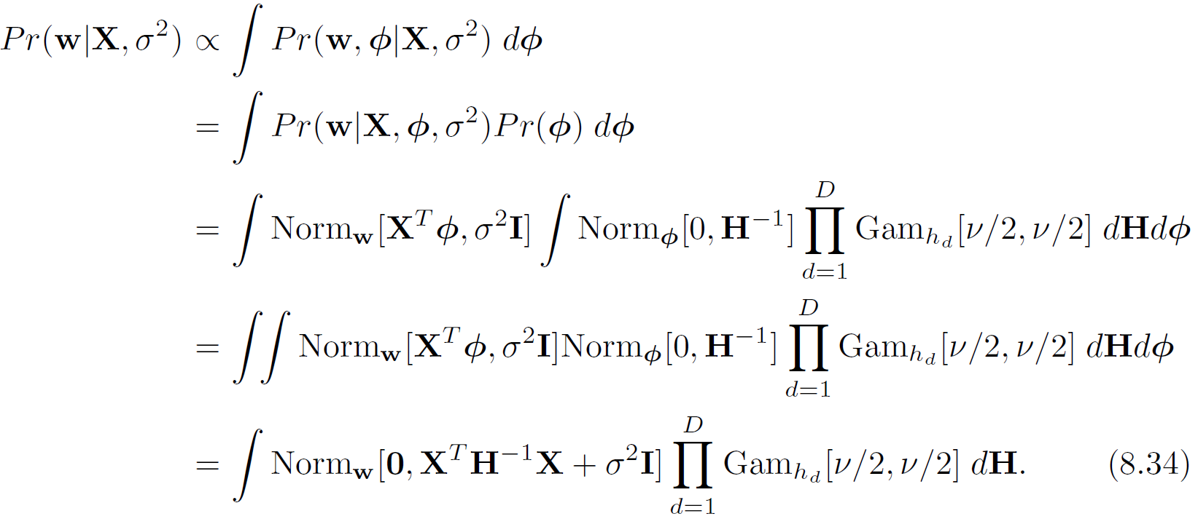
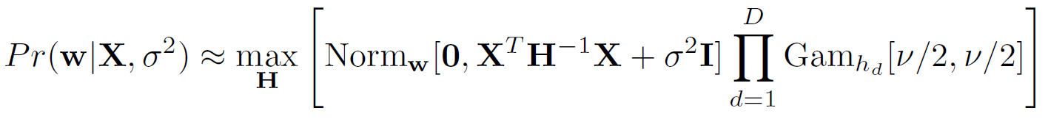
Sparse Linear Regression
Substituting in the prior
Still cannot compute, but can approximate
Computer vision: models, learning and inference. ©2011 Simon J.D. Prince
43

Slide 44
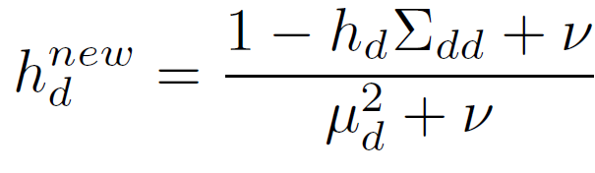



Sparse Linear Regression
这里为了更方便计算改一种表达
To fit the model, update variance σ² and hidden variables {h_{d}}.
To choose hidden variables
To choose variance
where
Computer vision: models, learning and inference. ©2011 Simon J.D. Prince
44

Slide 45

Sparse Linear Regression
这里左边是正常的linear reg
右边是稀疏 reg
左边考虑x1 x2两个特征，右边只考虑x1
所以右边好
After fitting, some of hidden variables become very big, implies prior tightly fitted around zero, can be eliminated from model
Computer vision: models, learning and inference. ©2011 Simon J.D. Prince
45

Slide 46
Sparse Linear Regression
Doesn’t work for non-linear case as we need one hidden variable per dimension – becomes intractable with high dimensional transformation. To solve this problem, we move to the dual model.
Computer vision: models, learning and inference. ©2011 Simon J.D. Prince
46

Slide 47
Structure
Linear regression
Bayesian solution
Non-linear regression
Kernelization and Gaussian processes
Sparse linear regression
Dual linear regression
Relevance vector regression
Applications
Computer vision: models, learning and inference. ©2011 Simon J.D. Prince
47

Slide 48



Dual Linear Regression
KEY IDEA:
Gradient Φ is just a vector in the data space
Can represent as a weighted sum of the data points
Now solve for Ψ. One parameter per training example.
Computer vision: models, learning and inference. ©2011 Simon J.D. Prince
48

Slide 49
Dual Linear Regression
Original linear regression:
Dual variables:
Dual linear regression:
Computer vision: models, learning and inference. ©2011 Simon J.D. Prince
49

Slide 50



Maximum likelihood
Maximum likelihood solution:
Dual variables:
Same result as before:
Computer vision: models, learning and inference. ©2011 Simon J.D. Prince
50

Slide 51




Bayesian case
Compute distribution over parameters:
Eq (8.48) Corrected
after 1st Ed.
Gives result:
where
Computer vision: models, learning and inference. ©2011 Simon J.D. Prince
51
Notes:
Corrected: Eq 8.48

Slide 52

Bayesian case
Predictive distribution:
where:
Notice that both the maximum likelihood and Bayesian case depend on dot products X^{T}X. Can be kernelized!
Computer vision: models, learning and inference. ©2011 Simon J.D. Prince
52

Slide 53
Structure
Linear regression
Bayesian solution
Non-linear regression
Kernelization and Gaussian processes
Sparse linear regression
Dual linear regression
Relevance vector regression
Applications
Computer vision: models, learning and inference. ©2011 Simon J.D. Prince
53

Slide 54
Regression Models
Computer vision: models, learning and inference. ©2011 Simon J.D. Prince
54

Slide 55

Relevance Vector Machine
Combines ideas of
Dual regression (1 parameter per training example)
Sparsity (most of the parameters are zero)
i.e., model that only depends sparsely on training data.
Computer vision: models, learning and inference. ©2011 Simon J.D. Prince
55

Slide 56


Relevance Vector Machine
Using same approximations as for sparse model we get the problem:
To solve, update variance σ² and hidden variables {h_{i}} alternately.
At end of training, data examples with high h_{i}’s can be discarded.
Computer vision: models, learning and inference. ©2011 Simon J.D. Prince
56

Slide 57





Learning RVM Parameters
Maximize (log) marginal likelihood, alternating
Compare to (previously seen) fitting Sparse Linear Regression Model
and
Notice that this only depends on dot-products and so can be kernelized!
(from last slide) Marginal Likelihood of Relevance Vector Machine:

Slide 58
Structure
Linear regression
Bayesian solution
Non-linear regression
Kernelization and Gaussian processes
Sparse linear regression
Dual linear regression
Relevance vector regression
Applications
Computer vision: models, learning and inference. ©2011 Simon J.D. Prince
58

Slide 59

Body Pose Regression (Agarwal and Triggs 2006)
人体的轮廓（silhouette）被编码成一个100x1的向量，而人体的姿势（body pose）则被编码为一个55x1的向量。这种编码方式把图像和姿势信息转换为机器学习模型可以处理的数值数据。
Encode silhouette as 100x1 vector, encode body pose as 55 x1 vector. Learn relationship
Computer vision: models, learning and inference. ©2011 Simon J.D. Prince
59

Slide 60

Shape Context
Returns 60 x 1 vector for each of 400 points around the silhouette
Computer vision: models, learning and inference. ©2011 Simon J.D. Prince
60

Slide 61

Dimensionality Reduction
Cluster 60D space (based on all training data) into 100 vectors
Assign each 60x1 vector to closest cluster (Voronoi partition)
Final data vector is 100x1 histogram over distribution of assignments
Computer vision: models, learning and inference. ©2011 Simon J.D. Prince
61

Slide 62

Results
2636 training examples, solution depends on only 6% of these
6 degree average error
Computer vision: models, learning and inference. ©2011 Simon J.D. Prince
62

Slide 63

Displacement experts
Computer vision: models, learning and inference. ©2011 Simon J.D. Prince
63

Slide 64
Regression
Not (yet) used as much in vision as classification
Main ideas all apply to classification:
Non-linear transformations
Kernelization
Dual parameters
Sparse priors
Computer vision: models, learning and inference. ©2011 Simon J.D. Prince
64

